Slide 1


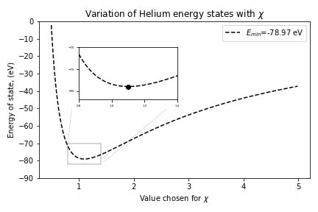
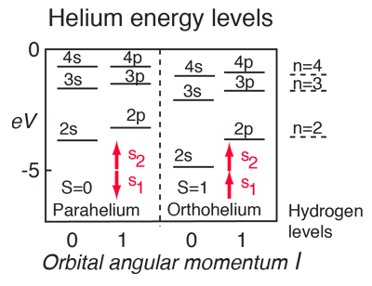
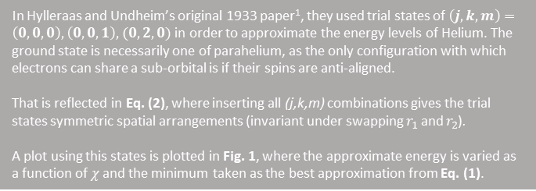
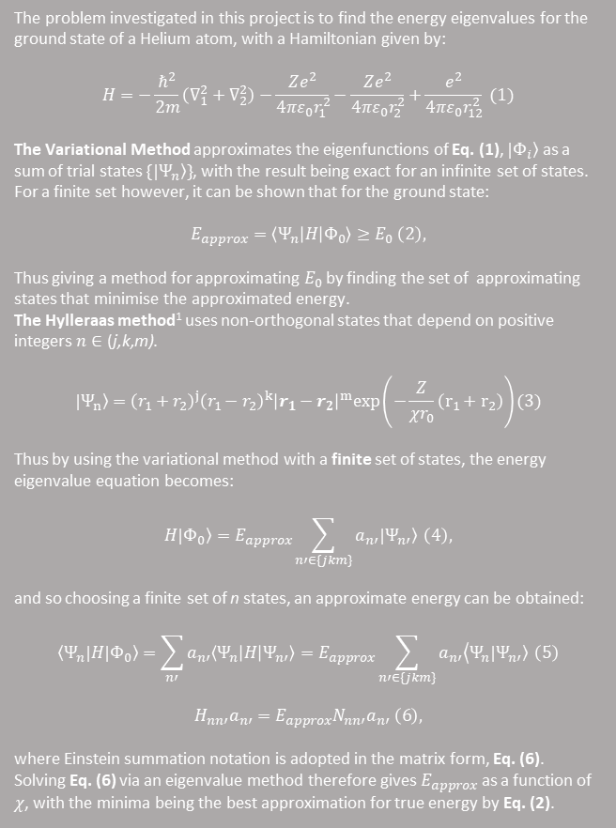

Benedict King
Department of Physics
Durham University
14th November 2020
Estimating the Ground State Energy of the Helium Atom
Coulomb interactions between electrons in the Helium atom mean that Helium’s energy spectrum must be found numerically. One method for this that is investigated in this project is to use the variational method with Hylleraas type wavefunctions to approximate the energy eigenstates.
The Background Theory
Hylleraas’ Original 3 State Approximation
Para- vs Orthohelium
The problem investigated in this project is to find the energy eigenvalues for the ground state of a Helium atom, with a Hamiltonian given by:
$$H=−\frac{ℏ^{2}}{2m}\left(∇_{1}^{2}+∇_{2}^{2}\right)−\frac{Ze^{2}}{4πε_{0}r_{1}^{2}}−\frac{Ze^{2}}{4πε_{0}r_{2}^{2}}+\frac{e^{2}}{4πε_{0}r_{12}^{2}} (1)$$
The Variational Method approximates the eigenfunctions of Eq. (1), $\left.{|Φ}_{i}\right\rangle$as a sum of trial states $\{|\left.Ψ_{n}\right\rangle \}$, with the result being exact for an infinite set of states. For a finite set however, it can be shown that for the ground state:
$$E_{approx}=\left\langle Ψ_{n} | H | Φ_{0}\right\rangle ≥E_{0} \left(2\right),$$
Thus giving a method for approximating $E_{0}$ by finding the set of approximating states that minimise the approximated energy.
The Hylleraas method¹ uses non-orthogonal states that depend on positive integers $n∈\text{(}\text{j}\text{,}\text{k}\text{,}\text{m}\text{)}$.
$$\left.{|Ψ}_{n}\right\rangle ={\left(r_{1}+r_{2}\right)}^{j}{\left(r_{1}−r_{2}\right)}^{k}{\left|r_{1}−r_{2}\right|}^{m}exp\left(−\frac{Z}{χr_{0}}\left(r_{1}+r_{2}\right)\right)(3)$$
Thus by using the variational method with a finite set of states, the energy eigenvalue equation becomes:
$$H|\left.Φ_{0}\right\rangle =E_{approx}\sum_{n′∈\{jkm\}}{a_{n′}|\left.Ψ_{n′}\right\rangle } \left(4\right),$$
and so choosing a finite set of n states, an approximate energy can be obtained:
$$\left\langle Ψ_{n}|\right.H|\left.Φ_{0}\right\rangle =\sum_{n′}{a_{n′}\left\langle Ψ_{n} | H | Ψ_{n′}\right\rangle }=E_{approx}\sum_{n′∈\{jkm\}}{a_{n′}\left\langle Ψ_{n}\right.|\left.Ψ_{n′}\right\rangle } \left(5\right)$$
$$H_{nn′}a_{n′}=E_{approx}N_{nn′}a_{n′} \left(6\right),$$
where Einstein summation notation is adopted in the matrix form, Eq. (6).
Solving Eq. (6) via an eigenvalue method therefore gives $E_{approx}$ as a function of $χ$, with the minima being the best approximation for true energy by Eq. (2).
In Hylleraas and Undheim’s original 1933 paper¹, they used trial states of $\left(j,k,m\right)=\left(0,0,0\right),\left(0,0,1\right),(0,2,0)$ in order to approximate the energy levels of Helium. The ground state is necessarily one of parahelium, as the only configuration with which electrons can share a sub-orbital is if their spins are anti-aligned.
That is reflected in Eq. (2), where inserting all (j,k,m) combinations gives the trial states symmetric spatial arrangements (invariant under swapping $r_{1}$ and $r_{2}$).
A plot using this states is plotted in Fig. 1, where the approximate energy is varied as a function of $χ$ and the minimum taken as the best approximation from Eq. (1).
‘The electron configuration with the maximum multiplicity has the lowest energy’ – Hund’s 1st Rule².
For energy levels greater than the ground state, orthohelium energy levels are below the equivalent energies in parahelium. This is due to Pauli’s exclusion principal, as a symmetric spin pairing forces an asymmetric spatial arrangement, which results in a greater average spatial separation between the electron pair and hence weaker coulomb interaction and a lower energy.
Fig. 2: Energy levels of the Helium atom, showing the discrepancy between ortho- and parahelium at excited energy states.²
Next Steps
Fig. 1: Plot of variation of the minimum $E_{approx}$ eigenvalue with χ for the three trial state case. The optimal approximation occurs when $χ=1.10$, and matches closely the true (experimental) value $E_{0}=−79.05 eV:$
A possible next stage in this investigation is to extend the variational method to find energies of excited states of Helium, by finding trial states that are orthogonal to an approximation of the true ground state of Helium and repeating the procedure laid out in this poster.
Another area of potential further investigation is to implement statistical techniques such as Monte Carlo simulation and optimisation algorithms to reinforce the results obtained by the variational method via different methodologies, and perhaps explore the energy states of atoms with more electrons than Helium also.³
References:
[1] E. A. Hylleraas and B. Undheim, Z. Phys. 65 (1930) 759. (in German), see translation in Macdonald Phy Rev D, 1933
[2] HyperPhysics, Georgia State University, ‘http://hyperphysics.phy-astr.gsu.edu/hbase/quantum/qnenergy.html’, last accessed 13/11/2020
[3] Martin, R., Reining, L., & Ceperley, D. (2016). Variational Monte Carlo. In Interacting Electrons: Theory and Computational Approaches (pp. 590-608). Cambridge: Cambridge University Press. doi:10.1017/CBO9781139050807.024

